Slide 1
生物医学信号处理综合实验
吉翔 白景峰
xiangji@sjtu.edu.cn

Slide 2
Lecutre 1

Slide 3
Review (Project 0)
Analog output
  Output points per period
  Frequency
  Equivalent output rate ≥ 2f
Analog input
  Sample rate (≥ Output rate)
Counter
  Frequency measurement
    Incorrect signal

Slide 4
Analog Input
Application
  Patient monitor (24/7)
    ECG (EKG)
    Heart rate
    etc
  Portable ultrasound imaging system
    B-mode & Doppler
    Doppler
    etc

Slide 5
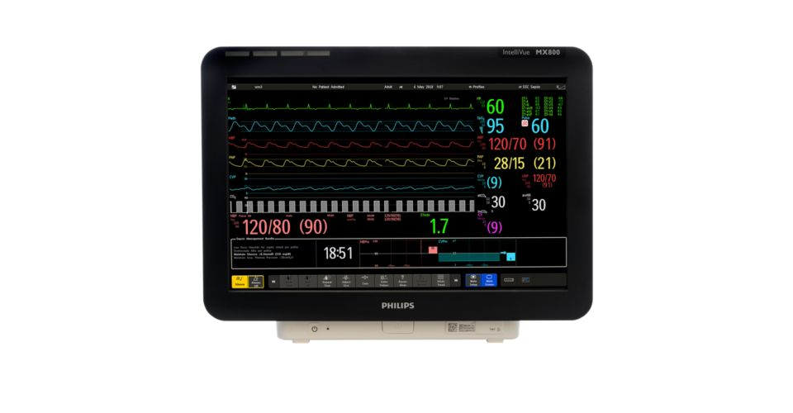
Examples
IntelliVue MX800 (Philips)
http://www.usa.philips.com/healthcare/product/HC865240/intellivue-mx800-bedside-patient-monitor0

Slide 6
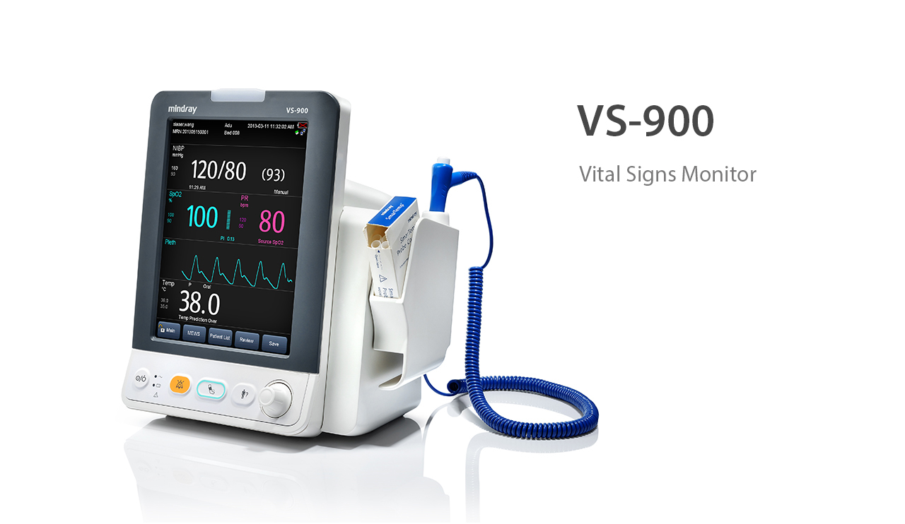
Examples
VS-900 (Mindray)
http://mindray.com/en/products/VS900.html0

Slide 7
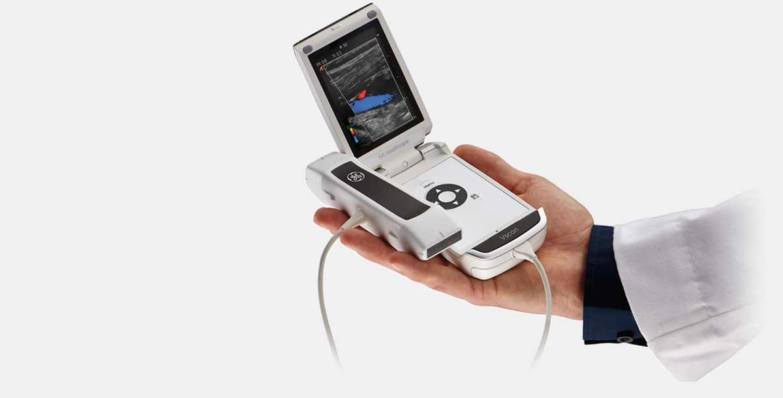
Examples
VSCAN (GE)
http://www3.gehealthcare.com/en/products/categories/ultrasound/vscan_portfolio/vscan_with_dual_probe

Slide 8
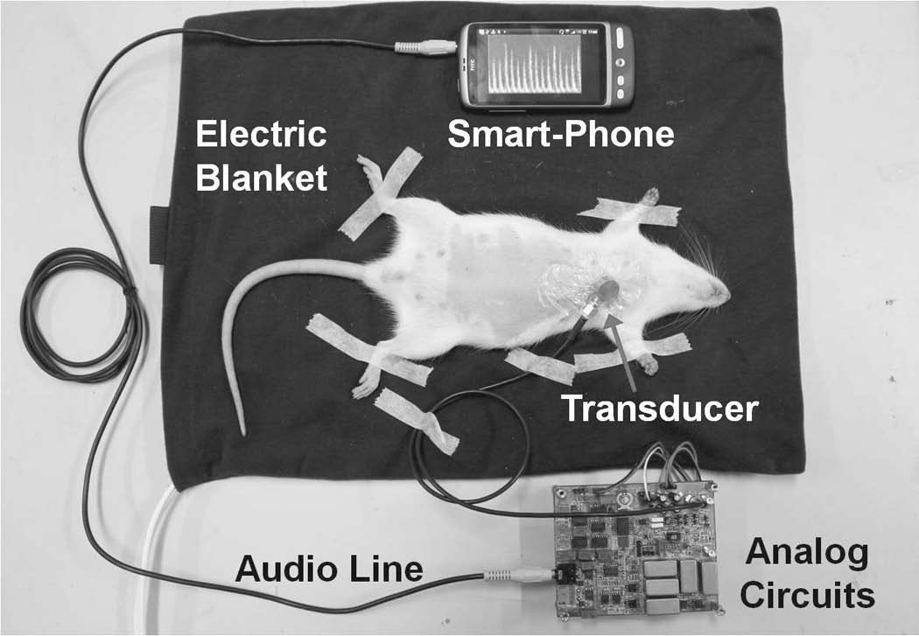
Examples
UFFC 59(1): 182-188, 2012

Slide 9
Project 1
Waveform generator
  Sine/Square
  f ≤ 100 Hz
Waveform display
  Real-time display
  Save data into file
Waveform replay
  Load data file
  Display waveform

Slide 10
Project 1
Waveform adjust (zoom in/out)
  Horizontal (time-axis)
  Vertical (voltage-axis)
Waveform process
  FFT
  Filter (square wave)
Optional
  Multiple channels
  Mouse event

Slide 11
Tools
USB-4704
Analog Discovery
DAQNavi SDK

